Slide 1
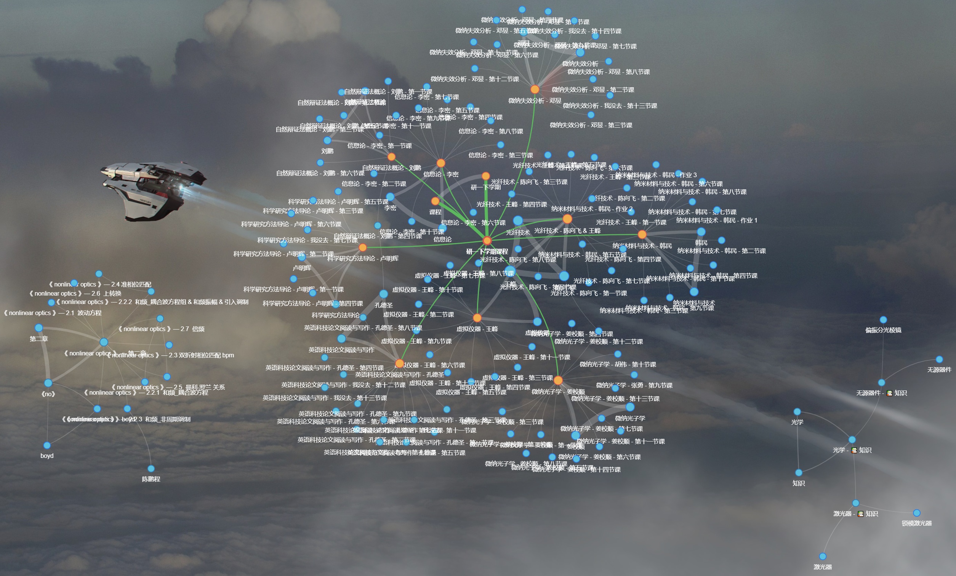
Create ← Your → Own
Bidirectional ←→ links

Slide 2
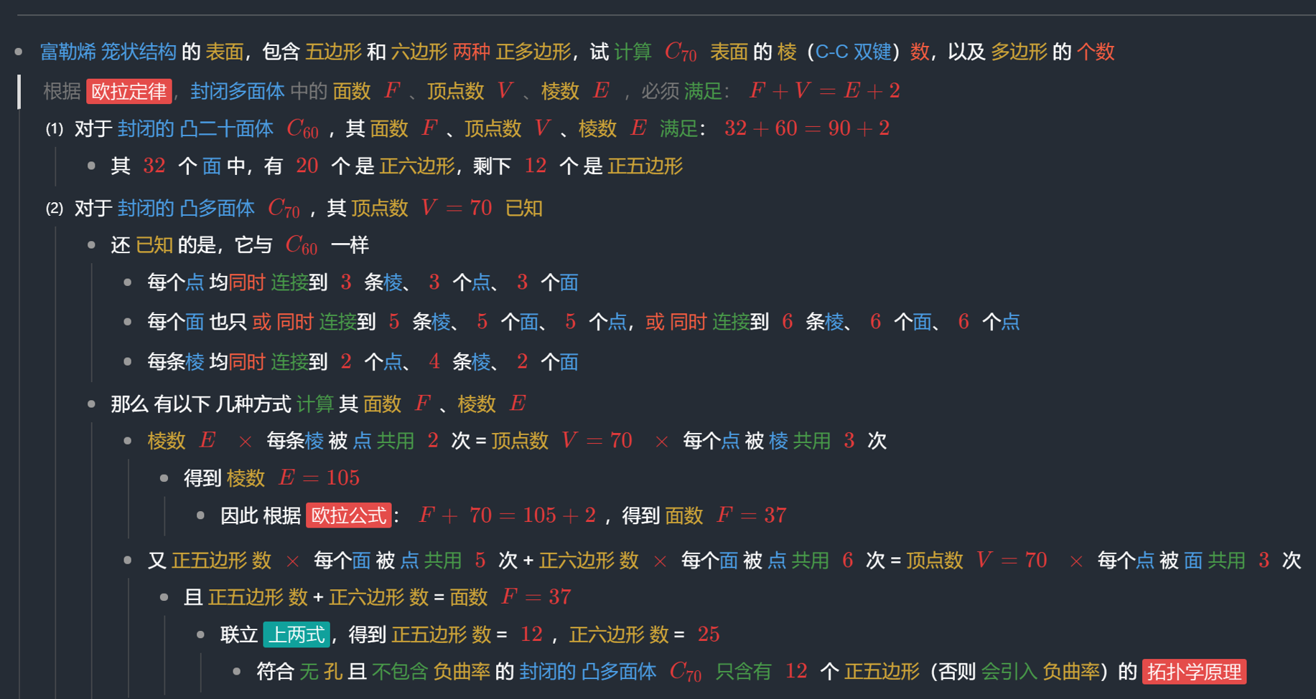
Follow → Your → Logic
总 • 分 | 并列

